Slide 1
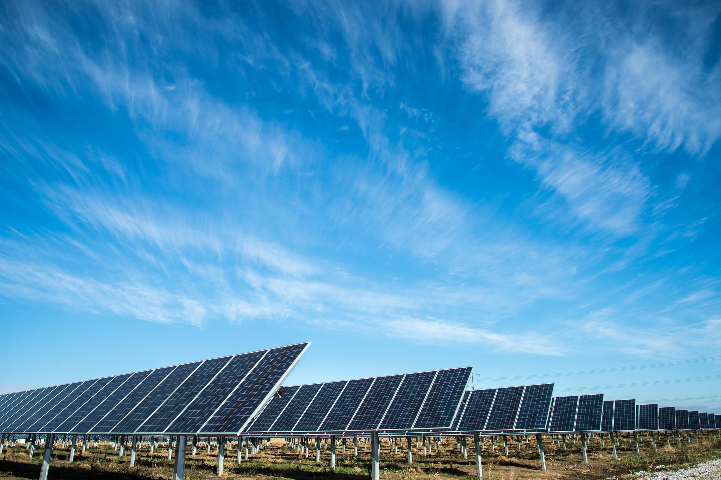
Team Zero
Amin Mansouri Jefry el Bhwash
Levy Duivenvoorden
Niels van Drunen
Niels van Schaik

Slide 2
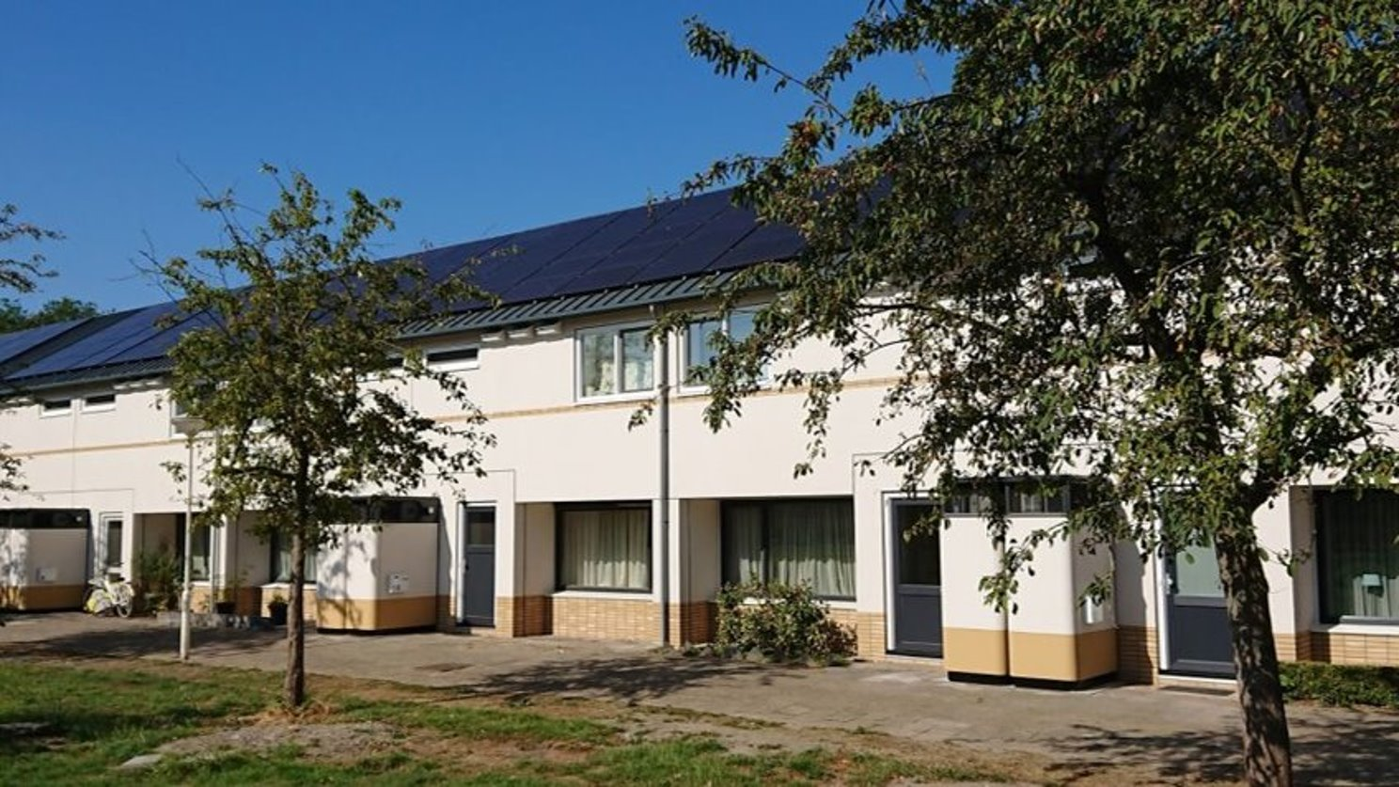
Factory Zero

Slide 3
Last week:
Improved NN
Started on a LSTM
Peak detection

Slide 4
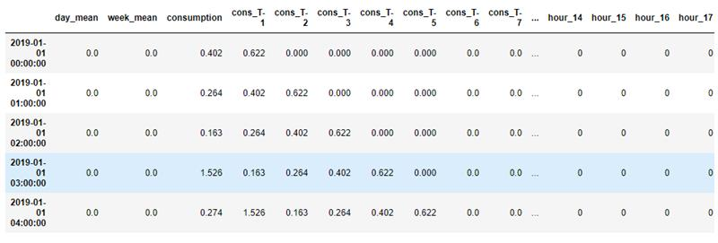
Improved Neural network
Improved Feature set
Notable ones:
Day mean
Week Mean
Cons_T-X
Hour of the day

Slide 5
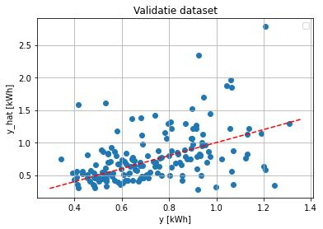
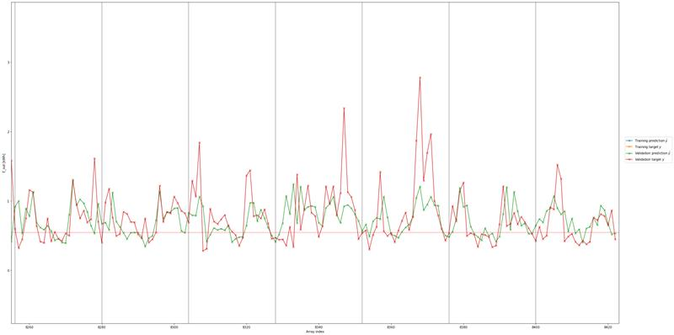
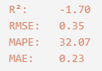
Improved Neural network
Validation

Slide 6
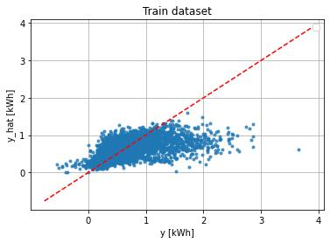
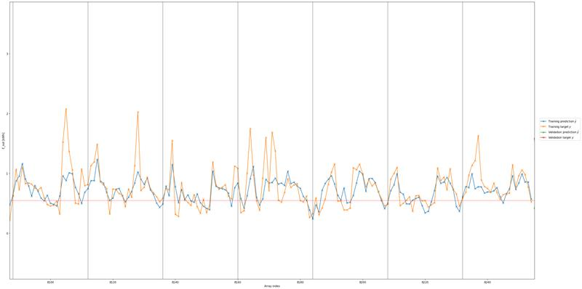
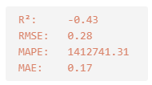
Improved neural network

Slide 7
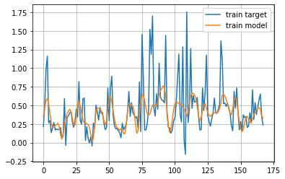
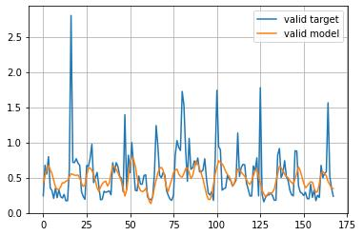
Started on LSTM (L1 loss)
Promising results
Still needs some work on it
Here is a small preview
Consumption
Consumption
Time
Time

Slide 8
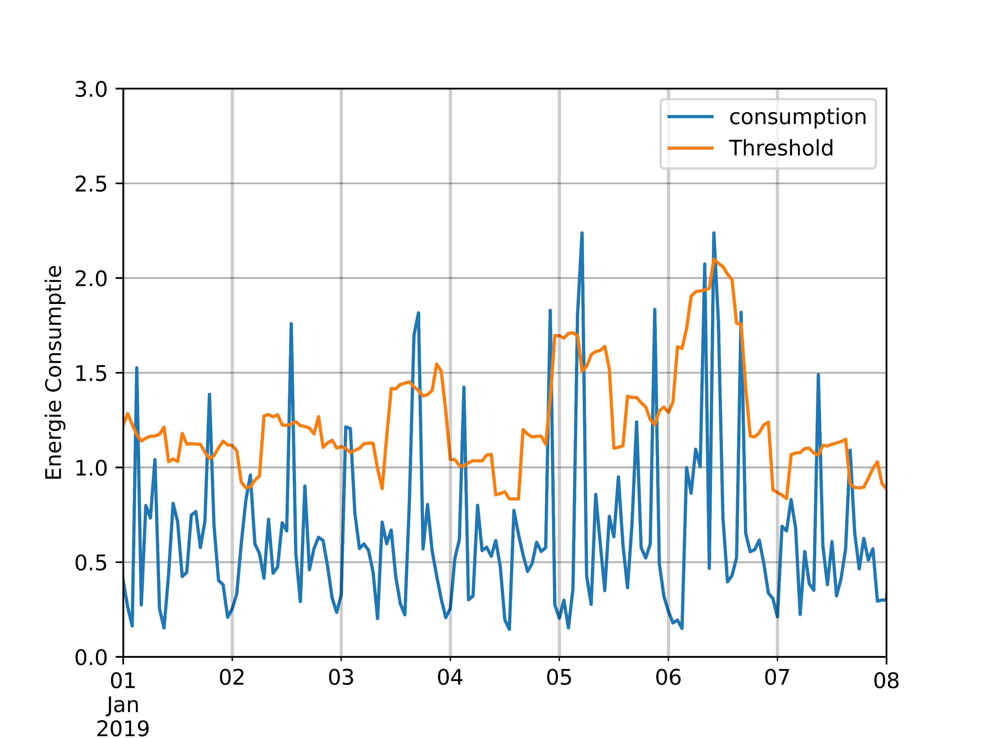
Peak detection
We worked on peak detection
Formula: (mean*1.3 + std * 1.01)
We can use this as a feature or a ground truth

Slide 9
Next week
Improve various models
Implement the peak detection

Slide 10
TU-Delft Lunch presentation
Teachers are welcome
Send us a message

